Slide 1
Indigo class trip to Paris Wednesday 20th March 2024
Parents’ information meeting

Slide 2
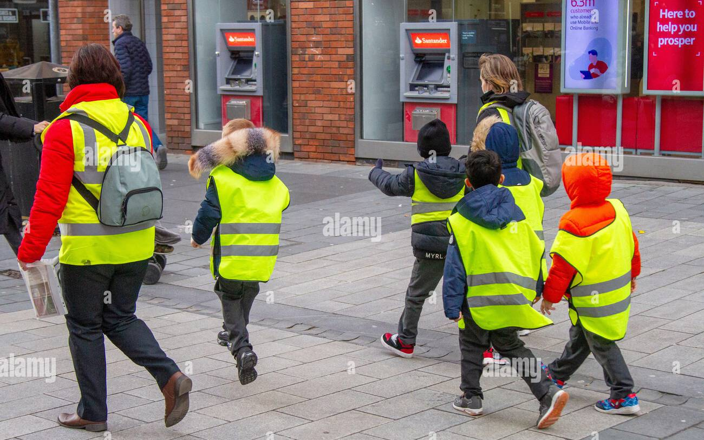
Staff supporting Paris trip
Charlotte Beddoes
Kate Stevens
Amanda Munn
Danielle Kothandaraman, named paediatric first aider
Helen Wasilewska, named first aider

Slide 3
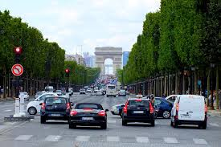
Safety briefing for children before the trip
Final details re organisation
Safety Briefing - crossing the road
Differences between the Metro and the Underground
Expectations re conduct whilst on the trip
Expectations re communicating and speaking French!
Reminder about what to bring and wear

Slide 4
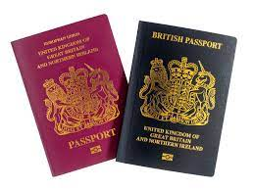
Final organisation
All passports and GHIC or EHIC cards and residency card must be brought to school by Monday 4th March. These will be carried by staff and handed back to the adult collecting your child at the end of the day.

Slide 5
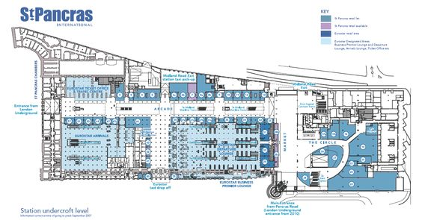
An early start!
Meet at 5:30am, St. Pancras International - opposite M&S food hall near Eurostar check in

Slide 6
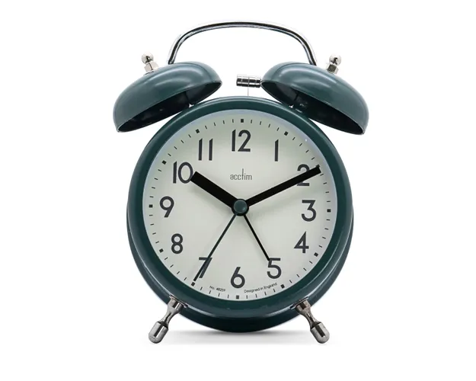
PLEASE BE ON TIME!
We need to check in at 5.35am.
We request the parents of children who have a residency card to stay in St Pancras until we all cross the border control as a precaution.
Each child will be given a high visibility vest and a wrist band with an emergency number on it.

Slide 7
Itinerary
Eurostar to Gare du Nord with croissants en route
Travel by Metro to the Museum of Architecture in Trocadero
Attend the workshop about Notre Dame de Paris delivered by the museum staff in English
Picnic in the Museum’s gardens. We won’t meet our penfriends this year.
Travel back into central Paris for a walking tour, taking in key sights around the city from Pont Neuf to Notre Dame de Paris (via gardens and river banks), St Michel area.
We will walk in total for around 30 minutes
Children will order crepes at rue St Andre des Arts
Take Metro back to Gare du Nord
Eurostar back to London, eating packed tea on the train

Slide 8
Blue by public transport
Black by foot

Slide 9
Your child will need:
To wear school uniform
A water bottle that can be refilled
Food for the picnic at lunch time and journey home ABSOLUTELY NO NUTS PLEASE
Waterproof jacket and comfortable shoes
A carrier bag (to sit on if it’s wet)
Camera - disposable film cameras are recommended (optional)
Books and small travel games are recommended
No phones, ipods or electronic gadgets
No money (crêpes will be paid by their group leader)

Slide 10
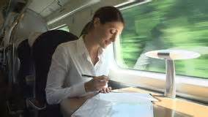
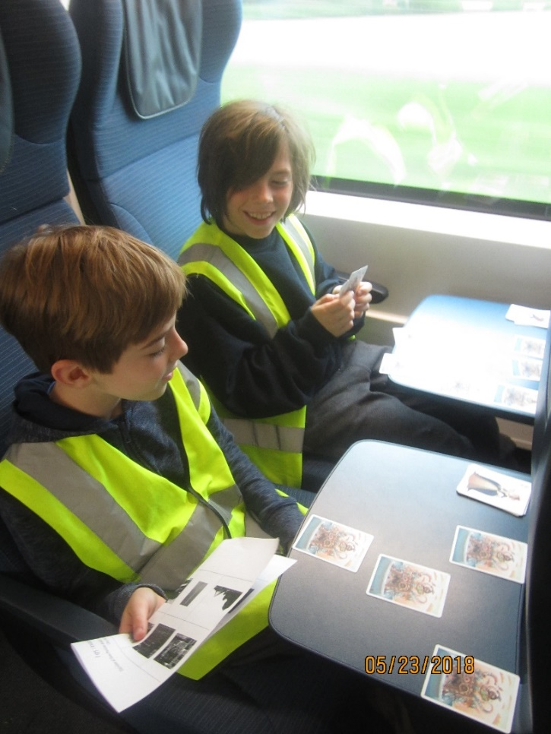
Eurostar passengers

Slide 12
Cité de Chaillot : Musée de l’architecture

Slide 13
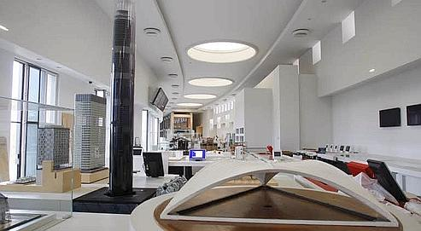
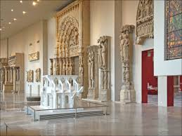

Slide 14
Arrival back in London
Please collect your child at 7:30pm at Eurostar arrivals.
You will be given an emergency contact number if you need to get a message to us after school hours.

Slide 15
Thursday 21st March
If you wish, children can come into school at 10am on the Thursday morning.

Slide 16
Please let us know….
If your child has any issues around …
needing the toilet frequently
travel sickness
any worries or concerns regarding the visit
in order to make the trip successful for your children.

Slide 17
Any questions?

