Slide 1

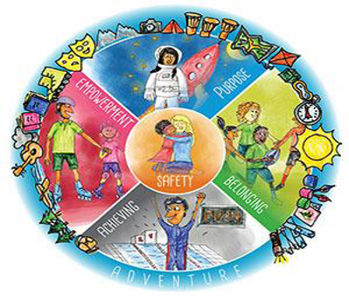

th
Using the Anchor Approach
At
St Aidan's VC Primary School
23 July, 2024

Slide 2
What is The Anchor Approach?
The Anchor Approach was set up by teachers to support children, parents, teachers , schools and the health services to work together to improve resilience and wellbeing for all.

Slide 3


Resilience helps us to manage the ups and downs of life. Resilient children are more likely to find healthy ways to deal with life’s difficulties. Children sometimes need help to build up their resilience.
Why is resilience so important?

Slide 4
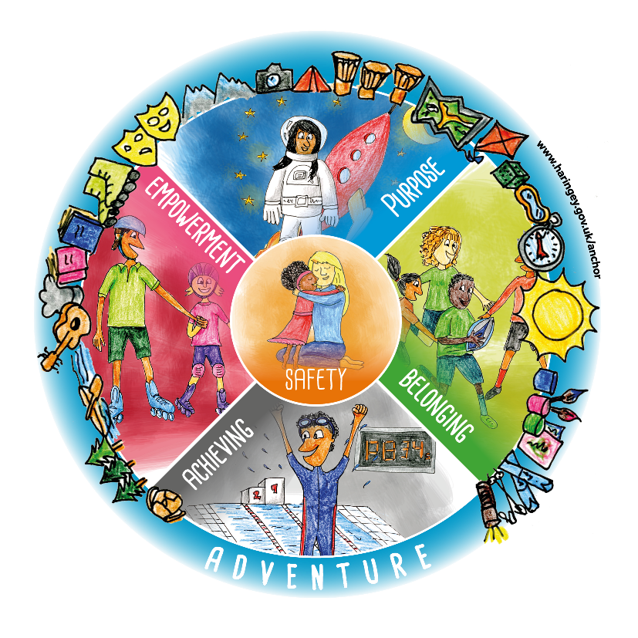
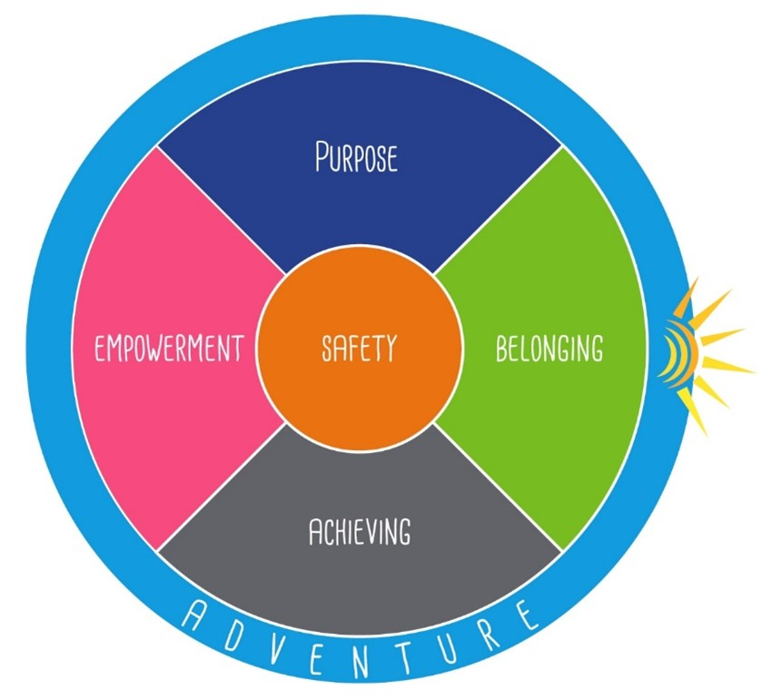
Children’s version
The Haringey Resilience Wheel

Slide 5
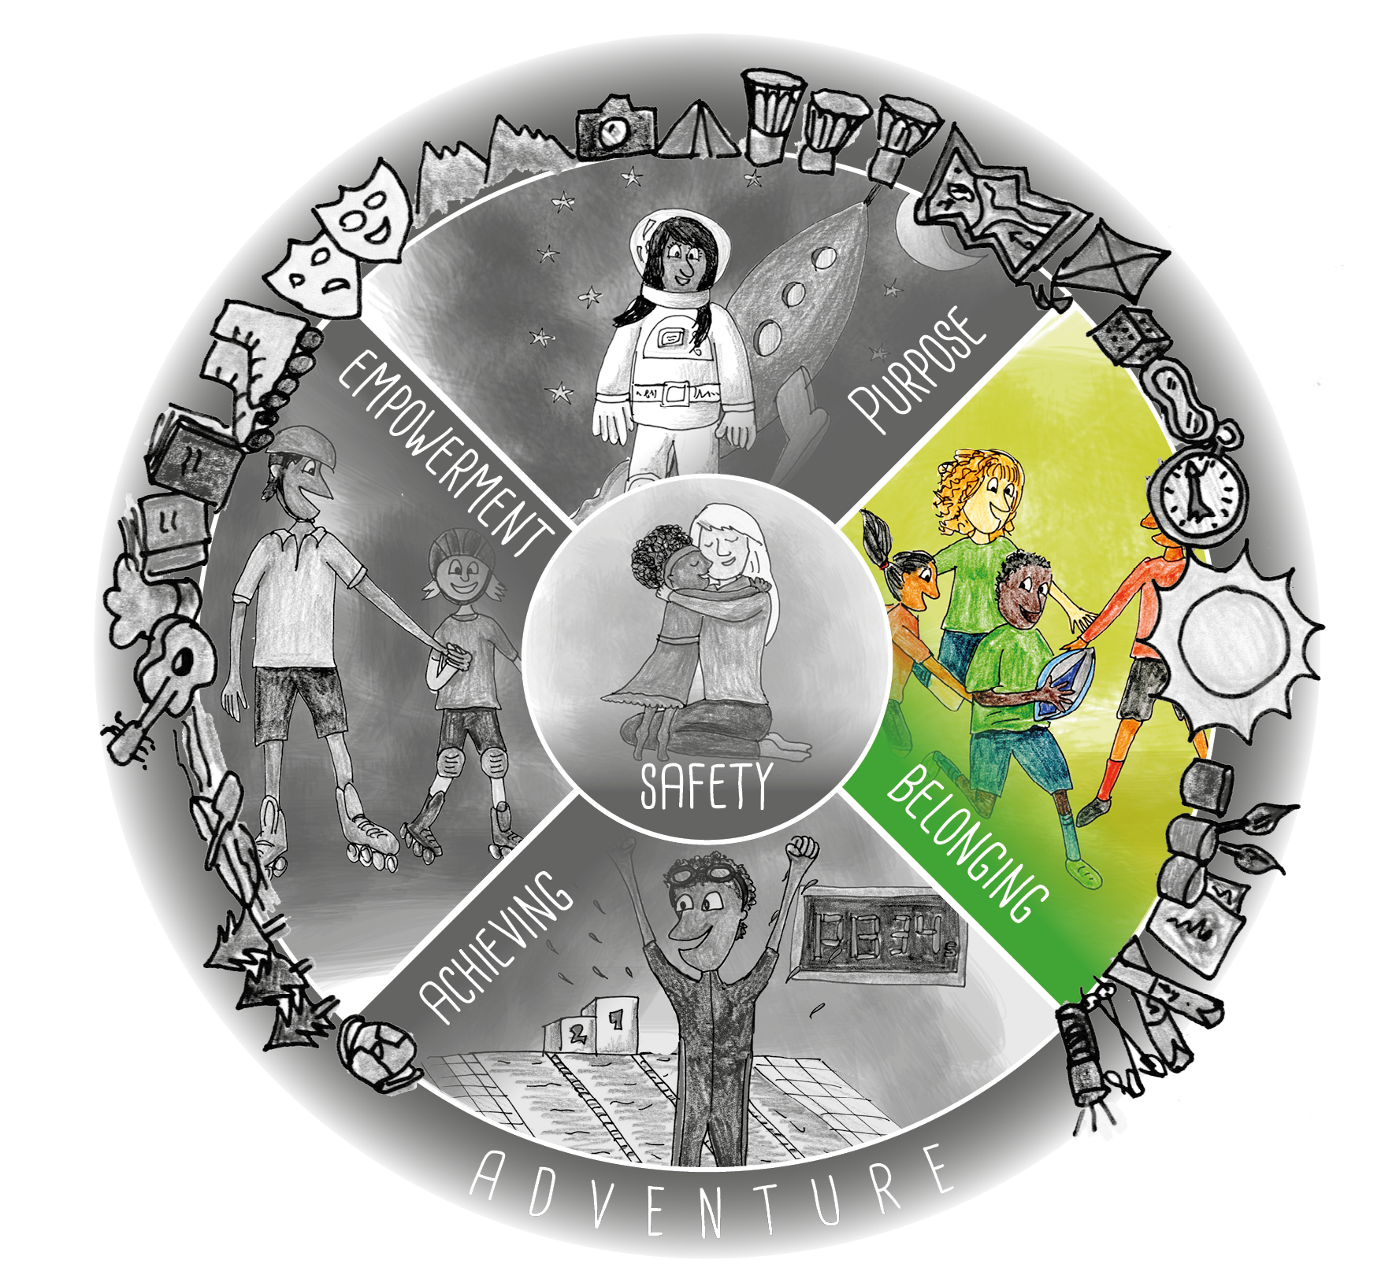

BELONGING
WHAT IT IS….. Feeling connected to others. Feeling accepted, understood, valued, and loved.
WHY WE NEED IT….
It helps us feel secure, develop trust in others and helps increase our confidence.

Slide 6
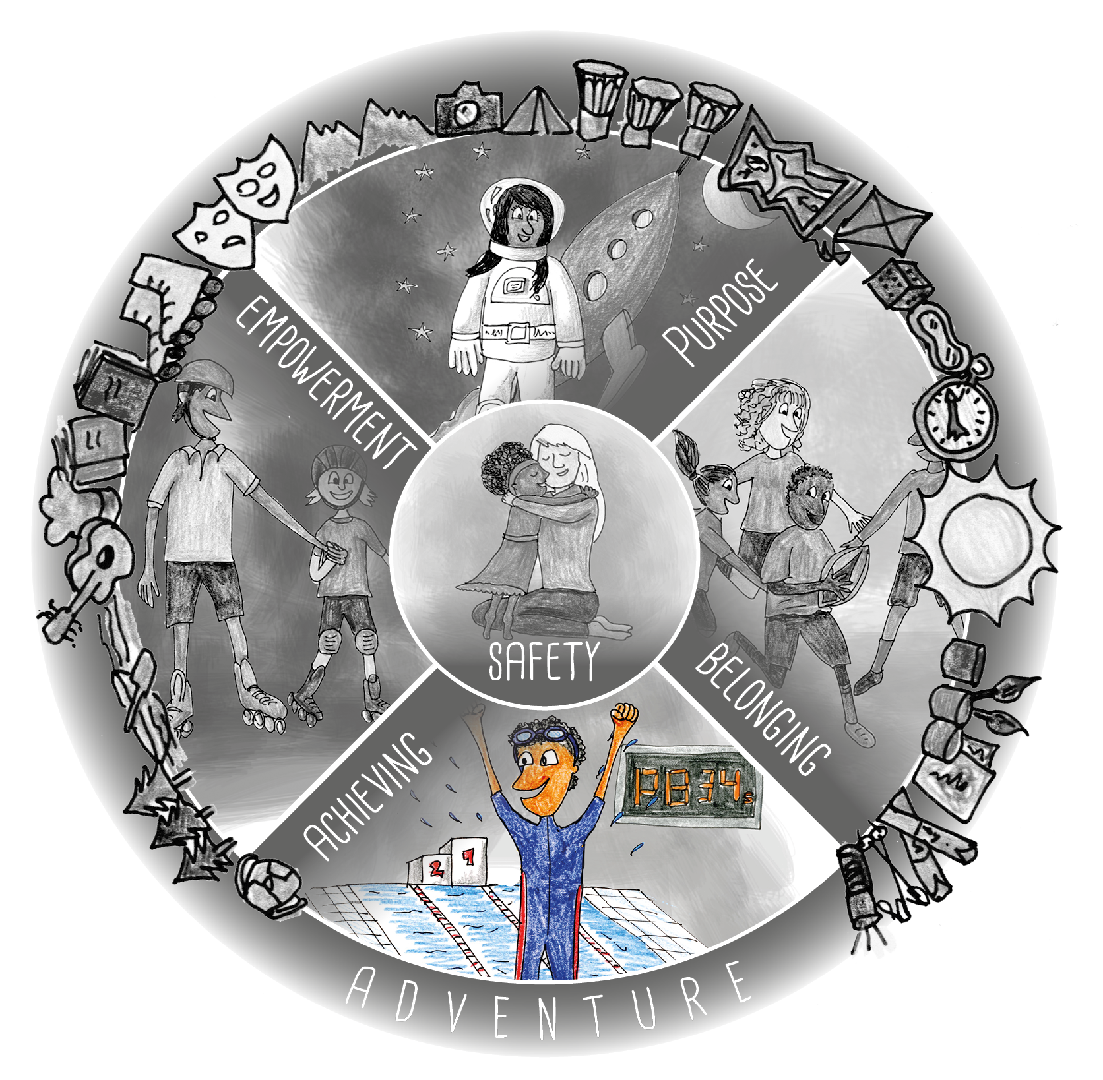
ACHIEVING
WHAT IT IS
Being successful, sharing skills with others. Celebrating success.
WHY WE NEED IT
Helps us feel good about ourselves. Creates a feeling of satisfaction, helps build our confidence.

Slide 7
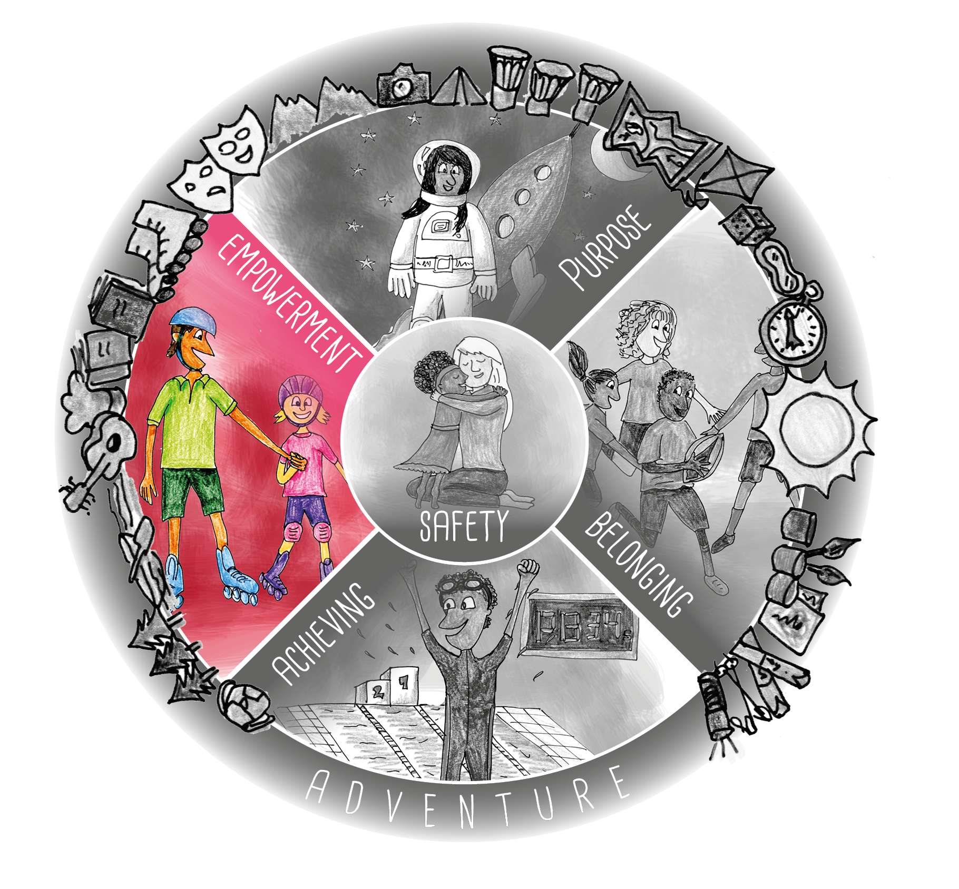
EMPOWERMENT
WHAT IT IS
Being listened to, having some choice and control.
WHY WE NEED IT
We all need to feel we have some control over our lives and that our opinions are valued. This gives us confidence to overcome challenges and have a more positive attitude.

Slide 8
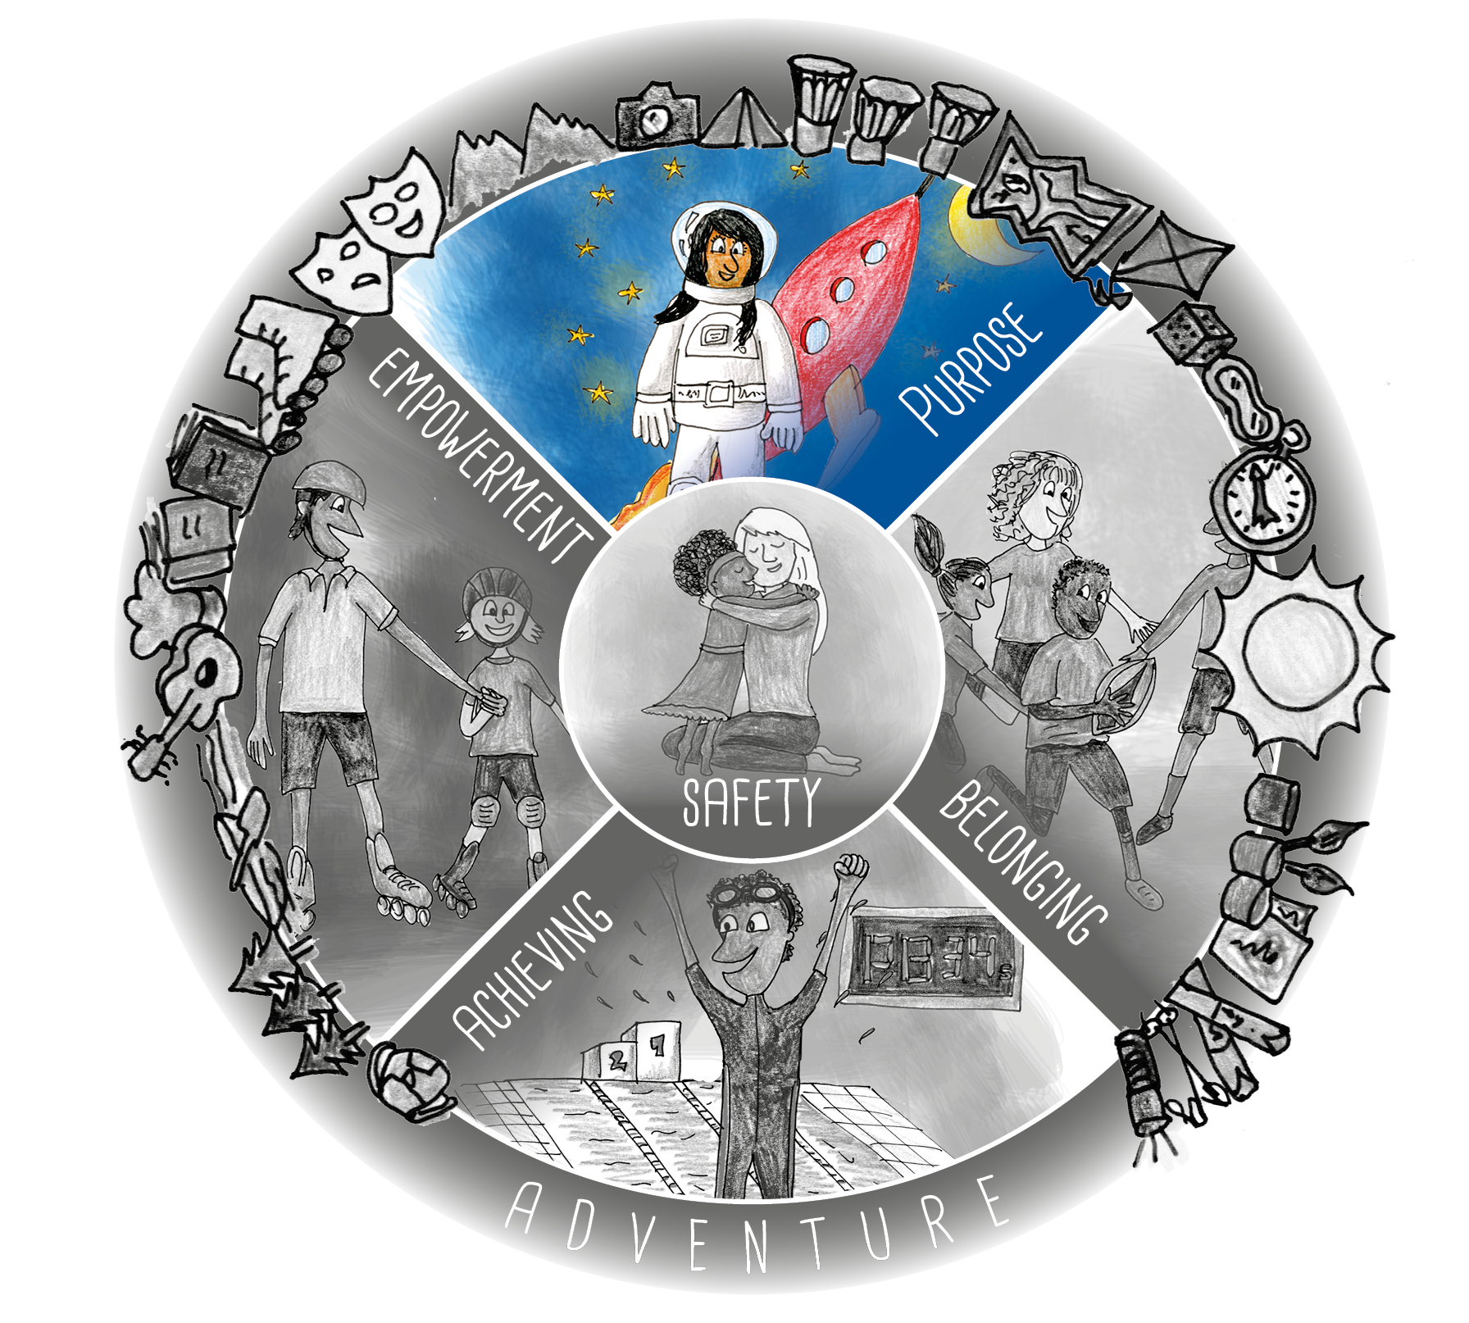
PURPOSE
WHAT IT IS
Helping others, contributing to community, feeling valued. Knowing our place in the future.
WHY WE NEED IT
Gives meaning to life and a positive sense of self because our view of ourselves is based on how other people view us.

Slide 9
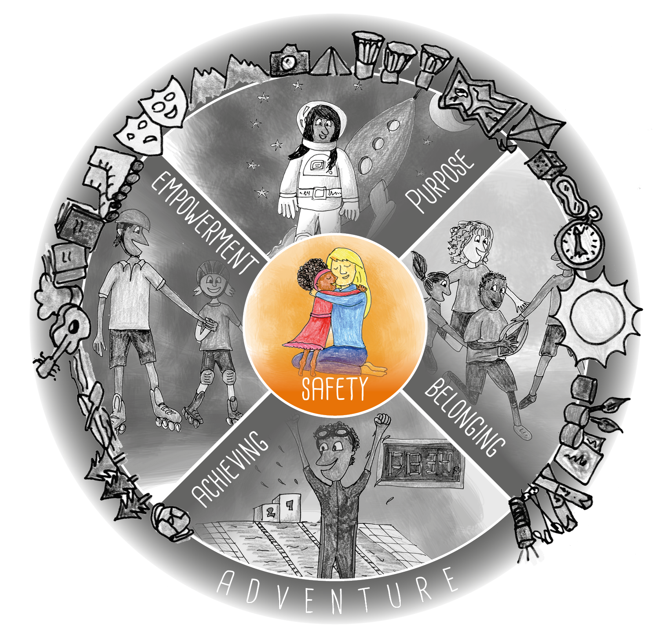
SAFETY
WHAT IT IS
Basic human needs – physical safety - food, shelter etc. Emotional safety, free from blame, sarcasm etc.
WHY WE NEED IT
Feeling safe helps our children to develop healthy ways to cope with difficult situations and they are better able to learn and grow

Slide 10
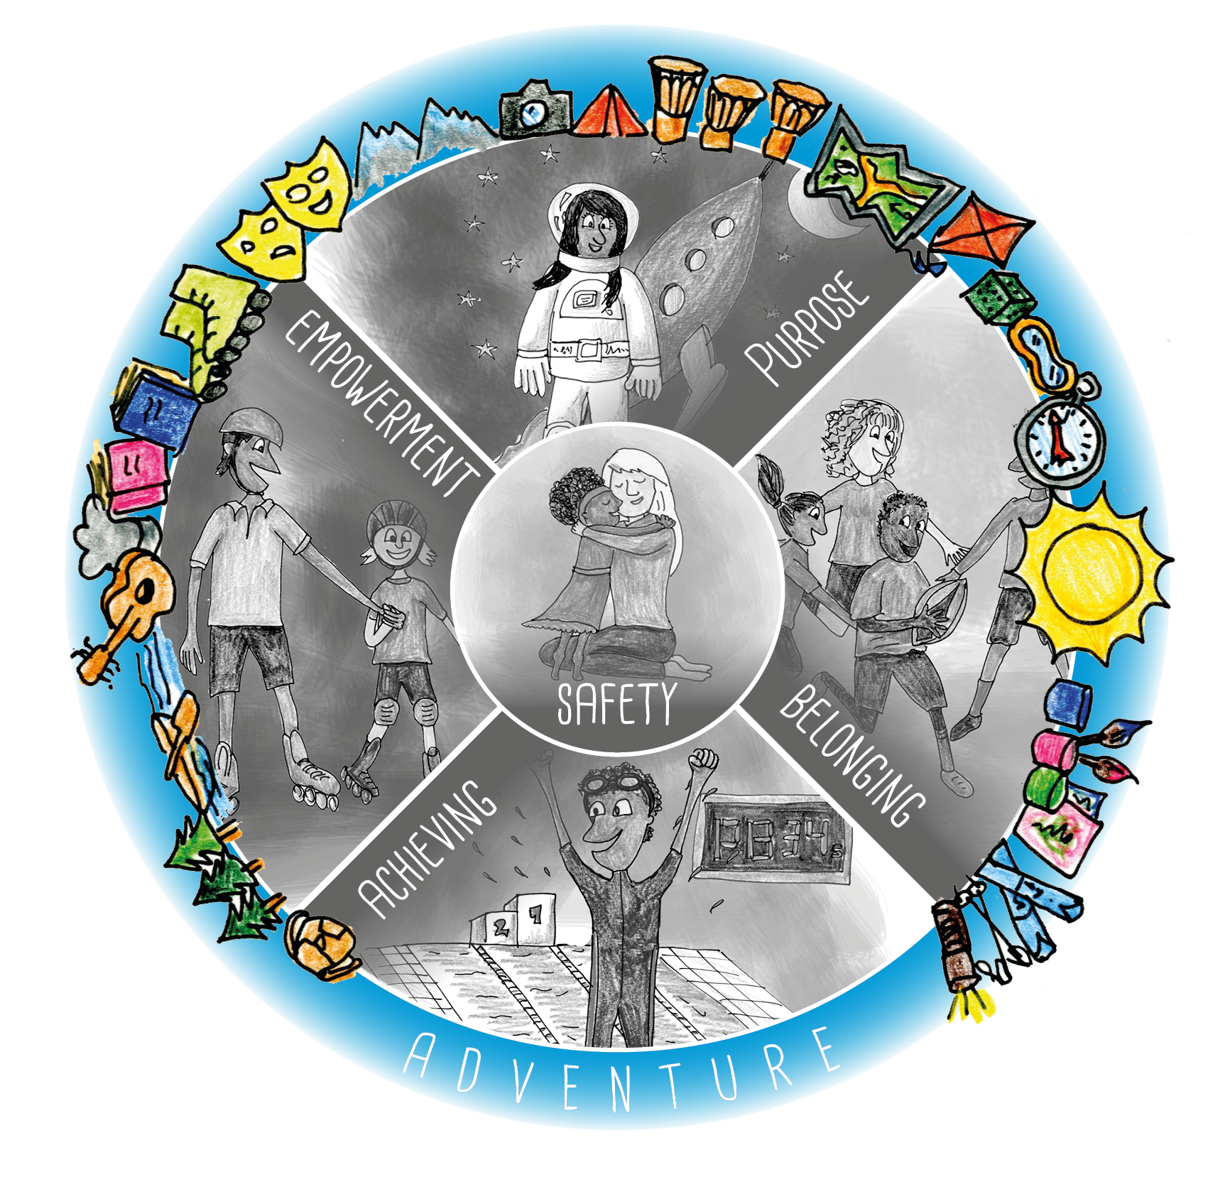
ADVENTURE
WHAT IT IS
Exploring new places, trying new things, and facing challenges or risks, often with a sense of discovery and enthusiasm
WHY WE NEED IT
Feeling a sense of adventure can bring a sense of joy and excitement and improve our wellbeing.

Slide 11
Using the
Anchor Approach
in school

Slide 12
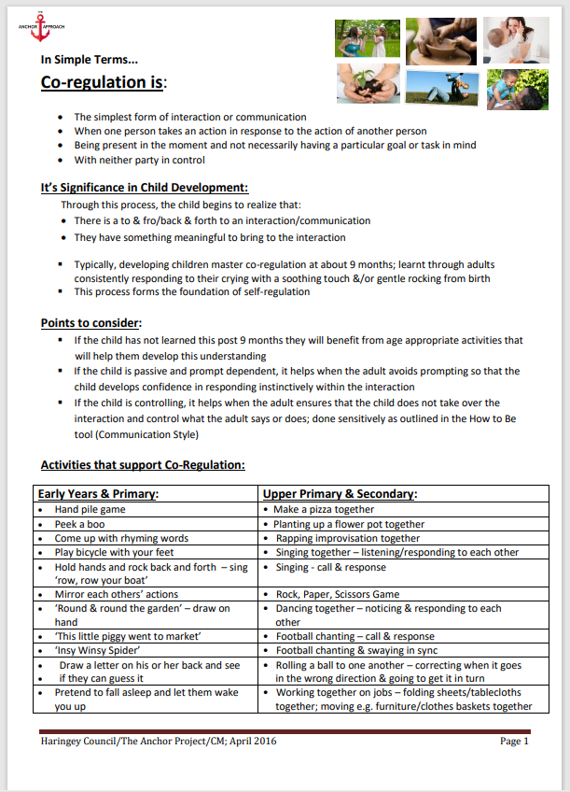
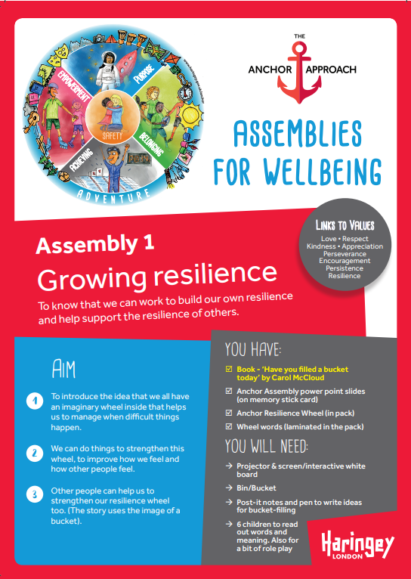
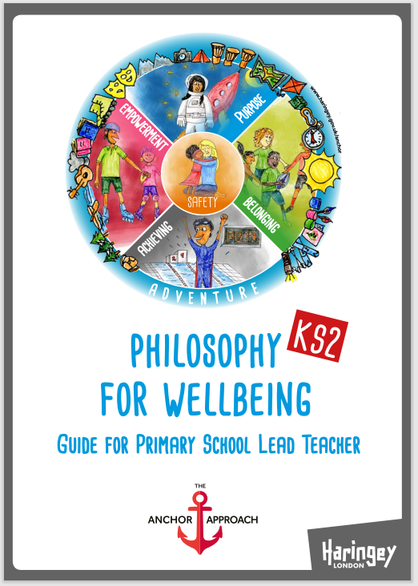




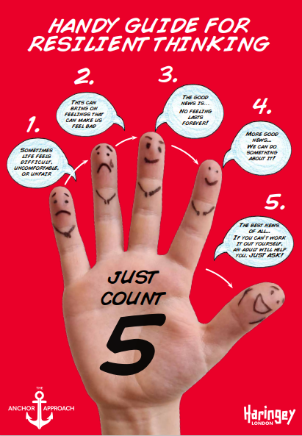
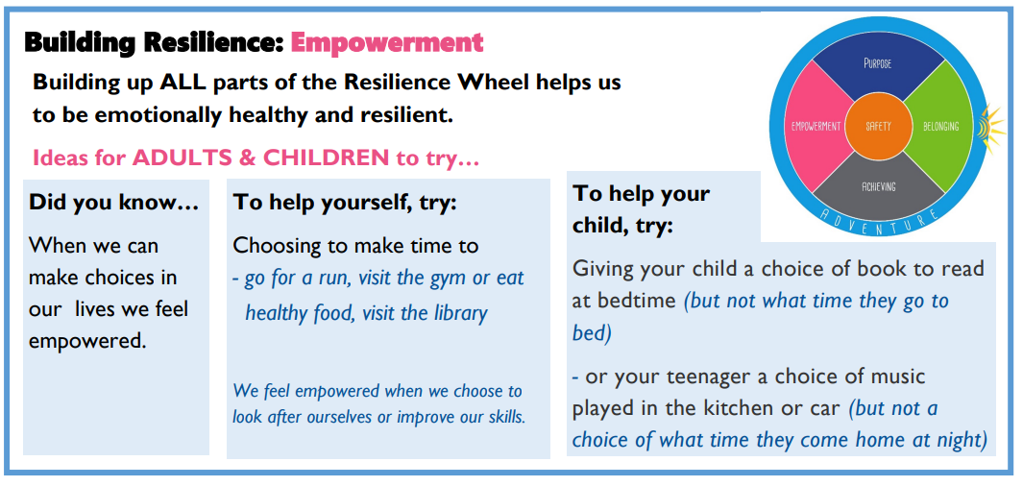
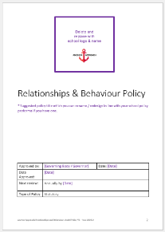



Philosophy Lessons
Through whole school assemblies
Training for staff
Tools to support children
In our policies and systems
Look out for Tips in our newsletters and on our school website

Slide 13
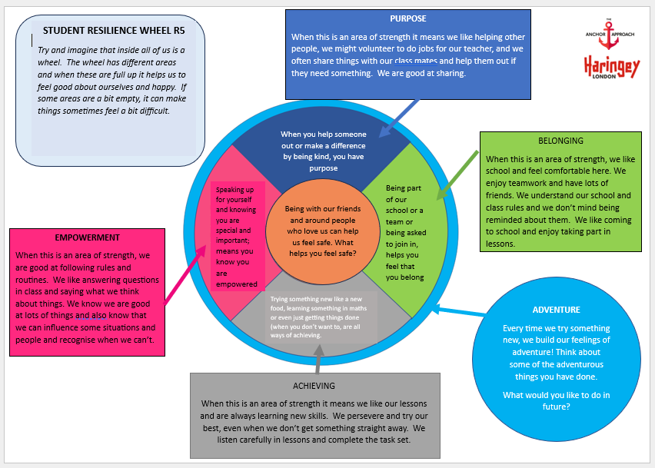
This resource helps children understand how each area of the Haringey Resilience Wheel can help them feel good about themselves.

Slide 14
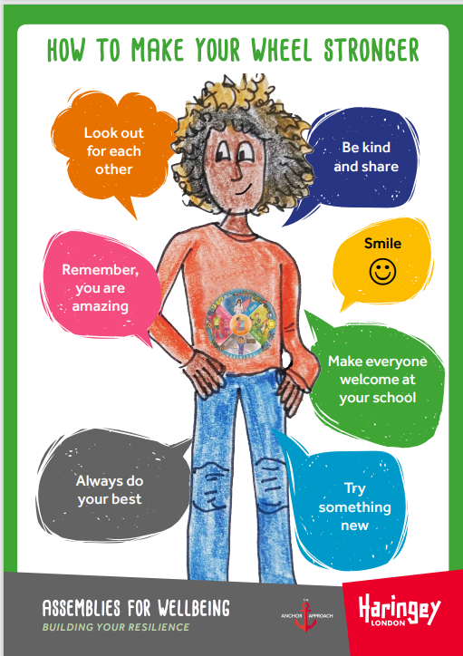
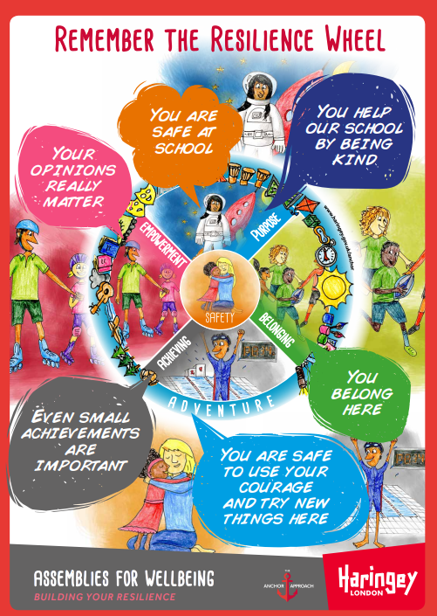
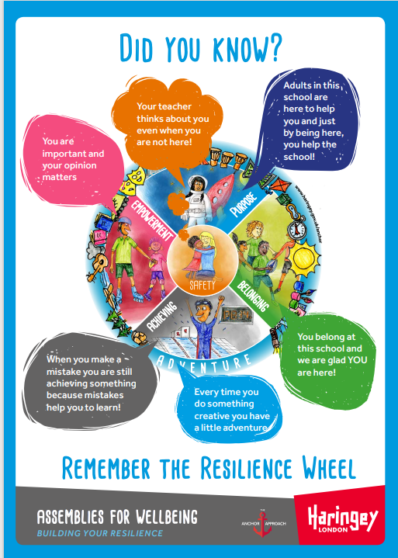
Posters to help children remember the areas in the Haringey Resilience Wheel

Slide 15
\
Staff Training in the Anchor Approach
All staff receive training on the principles and strategies of the Anchor Approach and try to :
Use emotionally friendly communication…listening to children, smiling, avoiding shame;
Use strategies like ‘Holding in Mind’ – a key strategy that helps build positive relationships with children (helping them know that we are thinking of them and remember things that are important to them).
Give children reasonable choices, being clear about non-negotiables
Identify children’s individual talents and skills
Find opportunities for children to be helpful

Slide 16
Things to try … building resilience
in our children

Slide 17
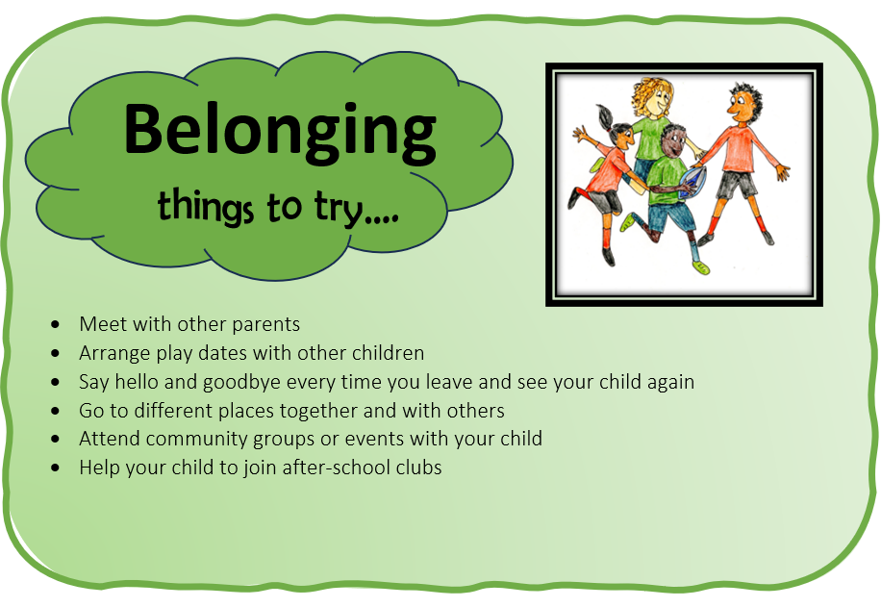

Slide 18
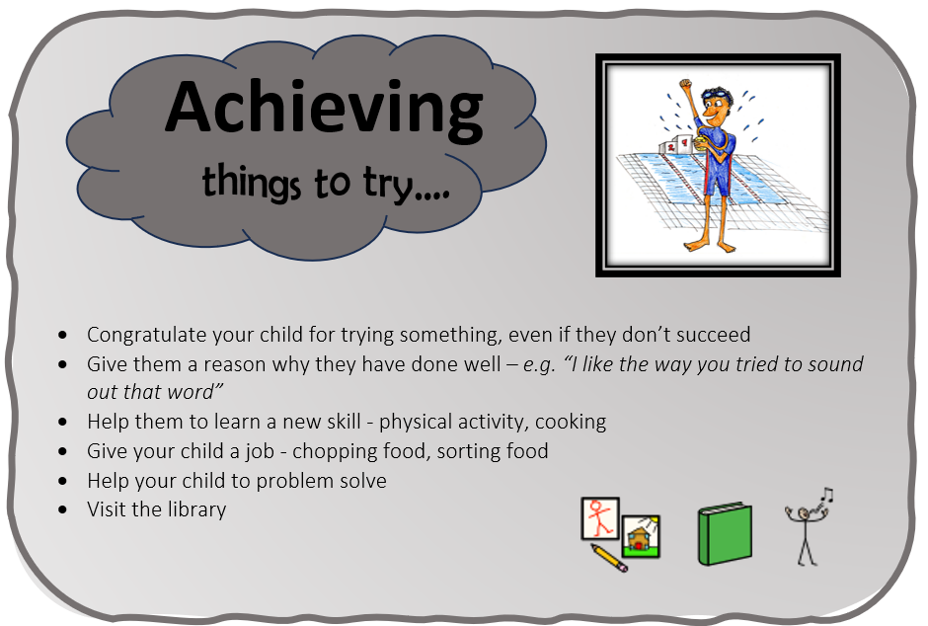

Slide 19
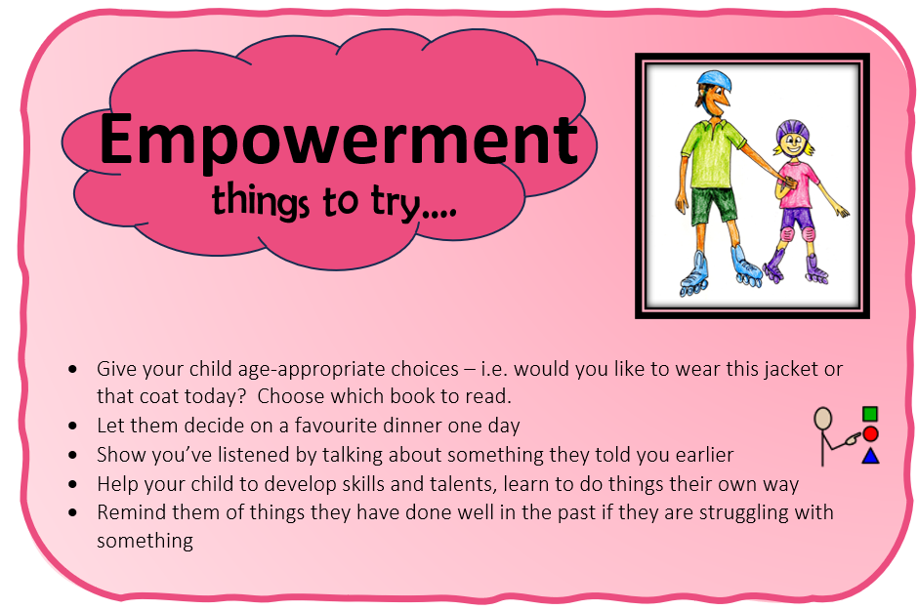

Slide 20
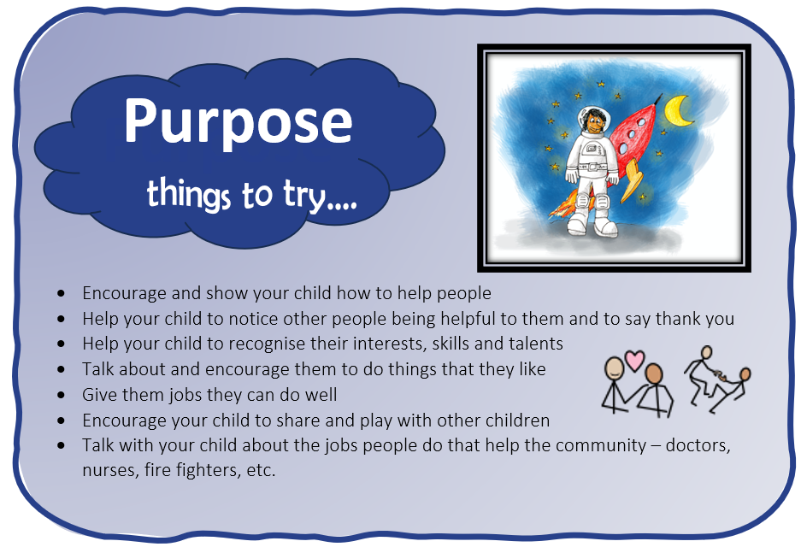

Slide 21
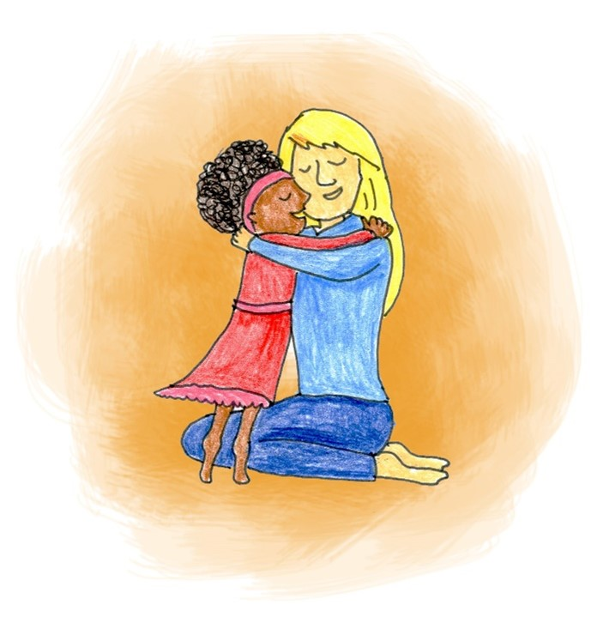
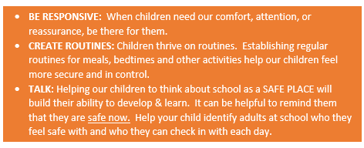
Safety
things to try …

Slide 22
OUR SCHOOL BEHAVIOUR POLICY

Slide 23
What is meant by ‘A Relationships-Based’
Approach?
Relationships are valued and any strategies that may damage relationship are avoided, where possible, with a focus on repairing and restoring relationships that have been damaged.
Building positive relationships with our children takes precedence and sanction-based approaches are avoided where possible.

Slide 24
Using the Anchor Approach
At
St Aidan's VC Primary School

